Slide 1


Respected Sir:
Faisal
Groups Members
Muhmmad Raza: 25F-CY-084
Ankeet Kumar: 25F-CY-097
Sagar Ali: 25F-CY-106
Date: 16/03/2026
DAWOOD UNIVERSITY OF ENGINEERING AND TECHNOLOGY

Slide 2
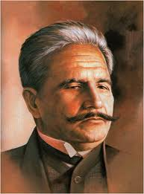
ALLAMA MUHAMMAD IQBAL (PHILOSOPHER AND POET)

Slide 3
Context
LIFE | 2
Education | 4
Career Life | 6
Iqbal’s Ideas | 7
Works in Persian | 9
Major Urdu Works | 11
English & Prose Works | 12
بال جبریل | 15
Allahabad Address (1930) | 16
POLITICAL PHILOSOPHY | 17
Towards the Muslim Identity | 19
Iqbal and Jinnah | 20
Iqbal’s Influence on | 22
Final years and Death | 23

Slide 4
LIFE
Early life and Family
He was born in Sialkot, Punjab on November 9, 1877.
He is the eldest among five siblings.
His father Shaikh Nur Muhammad was a prosperous tailor, well-known for his devotion to Islam.

Slide 5
His ancestors were Hindu Brahmins; his forefather Sahaj Ram Sapru embraced Islam.
At the age of 15, Iqbal married Karim Bibi who was the daughter of an affluent Gujarati physician.

Slide 6
EDUCATION
Initially, Iqbal was educated by tutors in languages and writing, history, poetry and religion.
He continued to study at the Scotch Mission College in Sialkot.
He then entered the Government College in Lahore to study Philosophy, English literature and Arabic, and obtained a Bachelor of Arts degree.

Slide 7
Later, he obtained a Bachelor of Arts degree from Trinity College at Cambridge in 1907.
He traveled to Germany to pursue his doctoral studies at Ludwig-Maximilians-Universityat Munich.
He studied law at Lincoln’s Inn in England and qualified for the bar in 1908.

Slide 8
CAREER LIFE
He is a leading Muslim poet, philosopher and political theorist.
He taught History, Philosophy and Political Science at Oriental College, Lahore.
While pursuing his Honors Degree, he taught Arabic at Cambridge University to substitute for Prof. Arnold.
Upon returning to India in 1908, Iqbal took up assistant professorship at the Government College in Lahore.
He also practiced law.
He was a very strong supporter of the revival of Islam around the world. He delivered a famous set of lectures in India, which was later compiled and published as The Reconstruction of Religious Thought in Islam (1930).
He worked in close collaboration with Mohammad Ali Jinnah (1876-1948).

Slide 9
FINAL YEARS AND DEATH
In 1933, Iqbal began suffering from a mysterious throat illness.
He spent his final years working to establish the Idara Dar-ul-Islam, an institution for studies in classical Islam and contemporary social science.
He stopped practicing law in 1934.
Died in Lahore on April 21, 1938.
Iqbal is the namesake of many public institutions including Allama Iqbal Open University and the Allama Iqbal International Airport in Lahore in what is now Pakistan.

Slide 10
IQBAL’S IDEAS
The idea of Pakistan was presented by Allama Muhammad Iqbal in 1930.He believed that Muslims of the subcontinent needed a separate homeland. In his Allahabad Address, he suggested a separate Muslim state. Later, this idea was supported and led by Muhammad Ali Jinnah, which resulted in the creation of Pakistan in 1947.

Slide 11
START OF POETRY
Iqbal started writing poetry at a young age.
He wrote poetry mainly in Urdu and Persian
Famous Works Of Iqbal:
Persian Books:
Asrar-e-Khudi
Rumuz-i-Bekhudi
Payam-i-Mashriq
Zabur-i-Ajam
Urdu works
Bang-i-Dara
Bal-i-Jibril
Zarb-i Kalim
Armughan-e-Hijaz
11

Slide 12

FAMOUS POETRY BOOKS
Bal-i-Jibril
جبرئیل: ہمدمِ دیرینہ کیسا ہے جہانِ رنگ و بو؟
ترجمہ: اے میرے پرانے ساتھی! بتاؤ زمین کی اس رنگین اور خوشبودار دنیا کا کیا حال ہے؟
جبرئیل: ہر گھڑی افلاک پر رہتی ہے تیری گفتگو، کیا نہیں ممکن کہ تیرا چاکِ دامن ہو رفو؟
ترجمہ: آسمانوں میں ہر وقت تمہارا ذکر رہتا ہے، کیا اب بھی کوئی صورت نہیں کہ تم اپنی غلطی درست کر لو اور توبہ کر لو؟

Slide 13
The Reconstruction of Religious Thought in Islam
Author: Allama Muhammad Iqbal (1930)
This refers to the presidential address delivered by Allama Muhammad Iqbal on December 29, 1930, at the annual session of the All-India Muslim League. It is considered a milestone in South Asian history because:
The Vision: Iqbal proposed the idea of an independent state for Muslim-majority provinces in northwestern India (Punjab, NWFP/Khyber Pakhtunkhwa, Sindh, and Balochistan).
Two-Nation Theory: It laid the intellectual groundwork for the concept that Hindus and Muslims were two distinct nations.
Significance: It is often viewed as the first formal articulation of what eventually became the demand for Pakistan.

Slide 14
ENGLISH & PROSE WORKS
Beyond poetry, Iqbal wrote extensively on law, economics, and religious philosophy.
The Development of Metaphysics in Persia (1908)
His doctoral thesis submitted to Munich University.
Ilm ul Iqtisad (1903)
His first book, written in Urdu, which was an introductory study of Economics.

Slide 15
POLITICAL PHILOSOPHY
Iqbal’s ideas have a great influence on the Islamic thinkers of the 20th century, especially on those in Pakistan.
His perspective on the role of religion in society has been extremely relevant to the Muslims.
He explains the concept of ‘khudi’ or ‘self’.
According to him, the aim of life is self realization and self knowledge.
One must realize that s/he is the vicegerent of Allah on earth.

Slide 16
According to Iqbal, the key to Muslims’ revival is the construction of Islamic thought and the adoption of Islamic identity.
Based on this premises, he promoted an independent idea of ‘The development of Muslin in India’.
As the representative of Indian Muslims in England, he suggested his idea of creating a homeland for Muslims in the South Asian subcontinent.
This is because of the oppression of Muslims by non-Muslims and the persistent denial of Muslims’ rights.

Slide 17
TOWARDS THE MUSLIM IDENTITY
He called upon Muslims to assert their identity through affiliation to the Islamic faith.
For him Islam is both a religious and political system.
He regards Tawhid (Unity of God) and Risalat (Prophet-hood of Muhammad) as the two determinants of a national identity for Muslims. To him, these two are sufficient to bind Muslims together.
His notion of ‘self’ is actually a call to action for Muslims to shape the development along the lines of Islamic culture.
In his philosophy, he takes religious foundation as the first principle for any society and argues that if a government is not based on religious values, it will become tyrannical.

Slide 18
IQBAL AND JINNAH
Mohammad Ali Jinnah took the leadership of the Indian Muslim League.
Iqbal convinced Jinnah that Hindu and Muslim were two separate (national) identities.
He urged Jinnah to return to India to lead the Muslims.
At that time the Pakistan movement gathered huge momentum.
Islam was used as the motivation force to rally the Muslims to the cause of creating a separate land for themselves, that is, Pakistan.

Slide 19
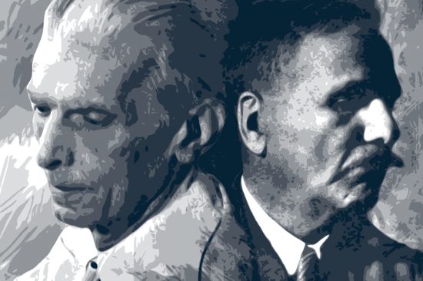
The demand of Pakistan was due to the denial of Muslims’ rights in the Indian subcontinent.
A deep sense of brotherhood united the Muslims and facilitated the victory of the Muslim League.
In 1947, India and Pakistan were created.
9 years after Iqbal’s death, Jinnah and the other politicians credited Iqbal as one of the visionaries, founder of the state and spiritual father of Pakistan.

Slide 20
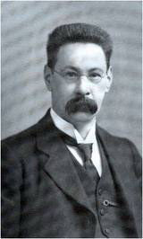
INFLUENCES
Iqbal was influenced by
Sir Thomas Walker Arnold
(1864-1930)
- British orientalist
- Iqbal’s teacher at the
Government College in Lahore.
- Arnold exposed Iqbal to Western cultures.
- With his encouragement Iqbal traveled to Europe and began his poetry writing and participated in politics.

Slide 21
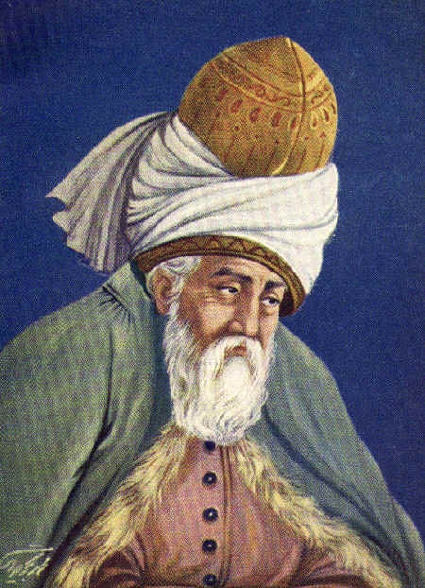
2.JALAL AL-DIN MUHAMMAD RUMI
- He deeply influenced Iqbal’s mind, as Iqbal’s writings focus on:
a) study on Islam
b) culture and history of Islamic
civilization
c) political future.
Iqbal regarded Rumi as his “guide” in
writing.

Slide 22
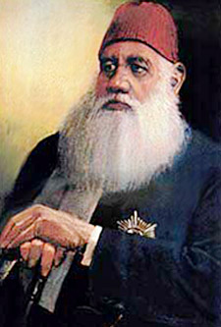
3. SAYYID AHMAD KHAN
- His idea of “Two Nation Theory”
was influenced by Sir Sayyid’s thoughts.

Slide 23
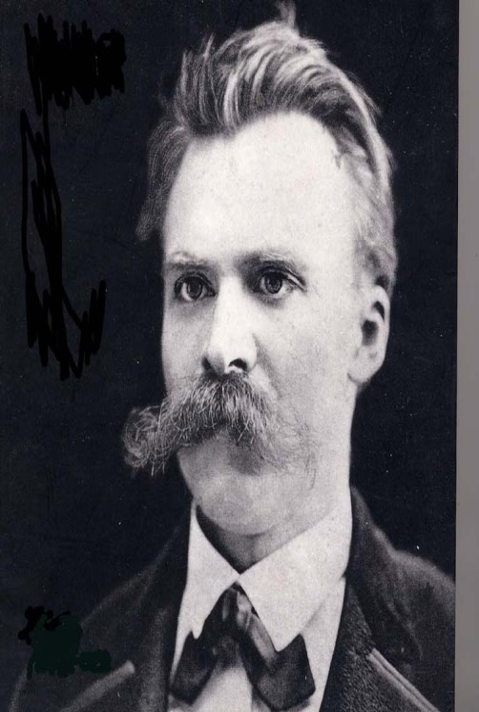
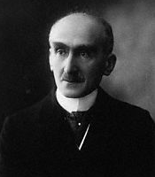
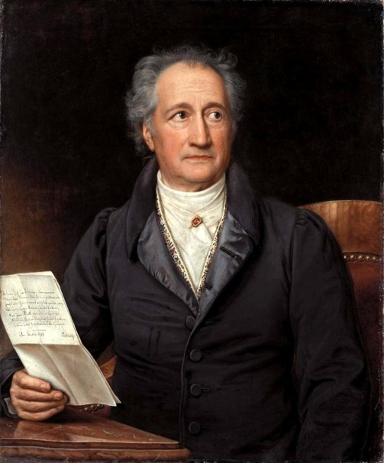
4. FRIEDRICH NIETZSCHE, HENRY BERGSON AND GOETHE.
- Western philosophers
- They made Iqbal a strong critic of Western society with their idea of separating religion from the state.

Slide 24

IQBAL’S INFLUENCE ON
The Indian Independence Movement (1857-1947)
- He was an active member of the All India Muslim League.
- His idea led to the creation of Pakistan as a Muslim state in
the South Asian subcontinent.

Slide 25
2. ISRAR AHMED (1932-2010)
- Pakistani Muslim religious scholar
- Founder of Tanzeem al-Islami (Islamic Revolutionary Thought) that argued that teachings of Qur’an and Sunnah must be implemented in the social, cultural, political, and economic spheres of life.

Slide 26
3. SYED ABUL ALA MAUDUDI (1903-1979)
- Pakistani journalist, theologian,
Muslim revivalist and political philosopher.
- He is the founder of Jamaat-e-Islami.
- Iqbal advised him to move from his
birthplace, Hyderabat, Deccan to
Pathankot and joined the Dar al-Islam
Trust Institute.

Slide 27
4. CHAUDRY NIAZ ALI KHAN (1880-1976)
- Civil engineer, civil servant, landowner and agriculturalist.
- Member of the All Indian Muslim League and
active supporter of the Pakistan Movement.
- Iqbal advised him to set up a research
institute for Islamic learning to educate new Muslim leaders to hold leadership roles in the new Muslim state — Pakistan.

Slide 28
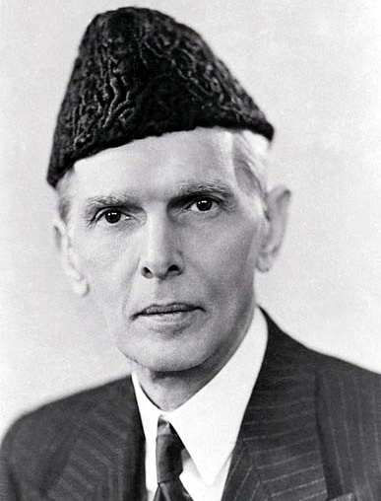
5. MUHAMMAD ALI JINNAH (1876-1948)
Lawyer, politician, statesman and widely known as the founder of Pakistan.
Honorific titles: Quaid e-Azam (the Great Leader),
Baba-e-Qaum (the Father of the Nation)
Leader of the All India Muslim League (1913-
1947)
- Went to London in 1892.
- Returned to India in 1896.
- Back to London in 1931.
- Back to India (persuaded by Iqbal) in 1936
to reunite the Muslim League and founded
Pakistan in 1947.

Slide 29
ہر اک مقام سے آگے بڑھنے کا ہے پیغام رکنا نہیں ہے تجھے، یہ دنیا ہے تیرا امتحان THANK YOU (PREPARED BY ANKEET KUMAR)

